Slide 1

Charger distribution for
electric vehicles in Munich
Presented by :
Georg Ammer
Thomas Loesekann
Janis Kropp

Slide 2
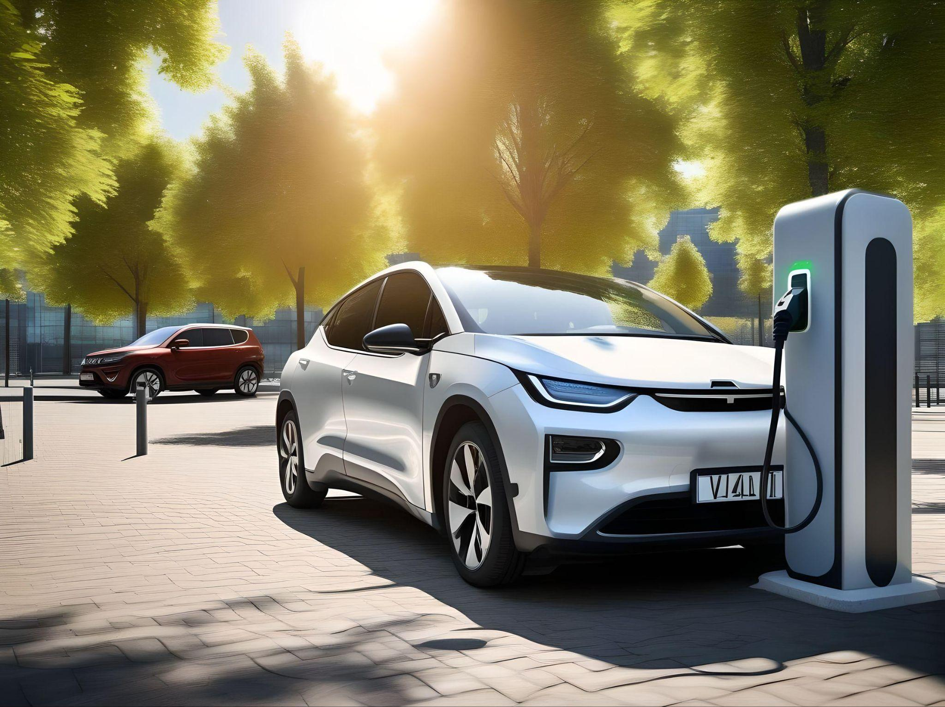
Motivation
How many chargers are available
Where are the chargers located
What is the need for the future

Slide 3
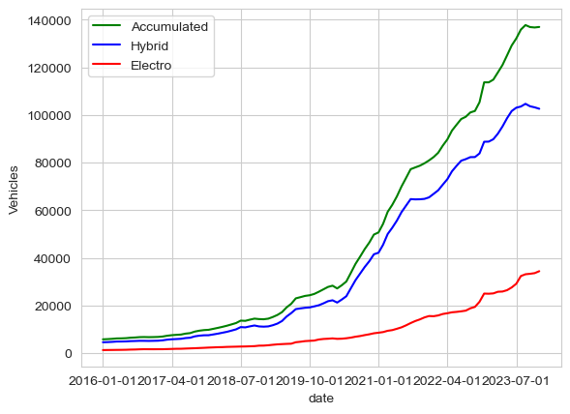
Situation
Electrical cars
In Munich :
34371 electric
102116 hybrid
136967 overall

Slide 4
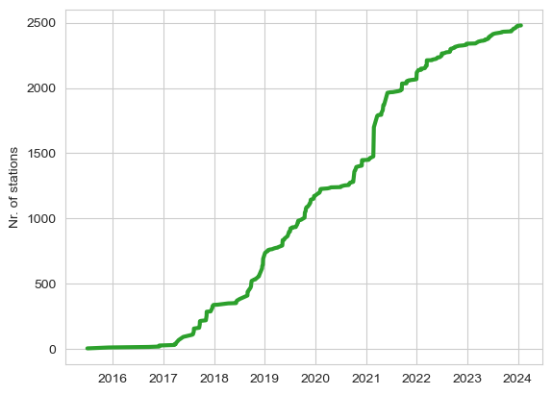
Charging stations
Installed charger over until today : 2414

Slide 5
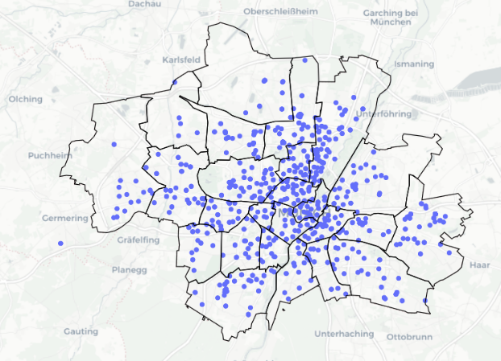
Munich charger location
Munich is divided
in 25 districts with
10 to 662 chargers per district

Slide 6
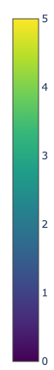
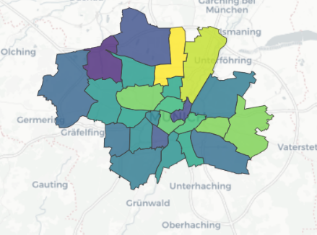
Charger density per car and district
per 1000 cars

Slide 7
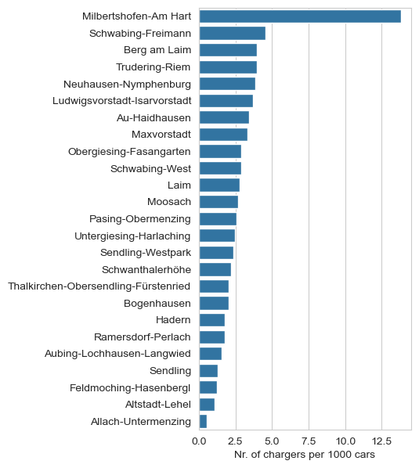
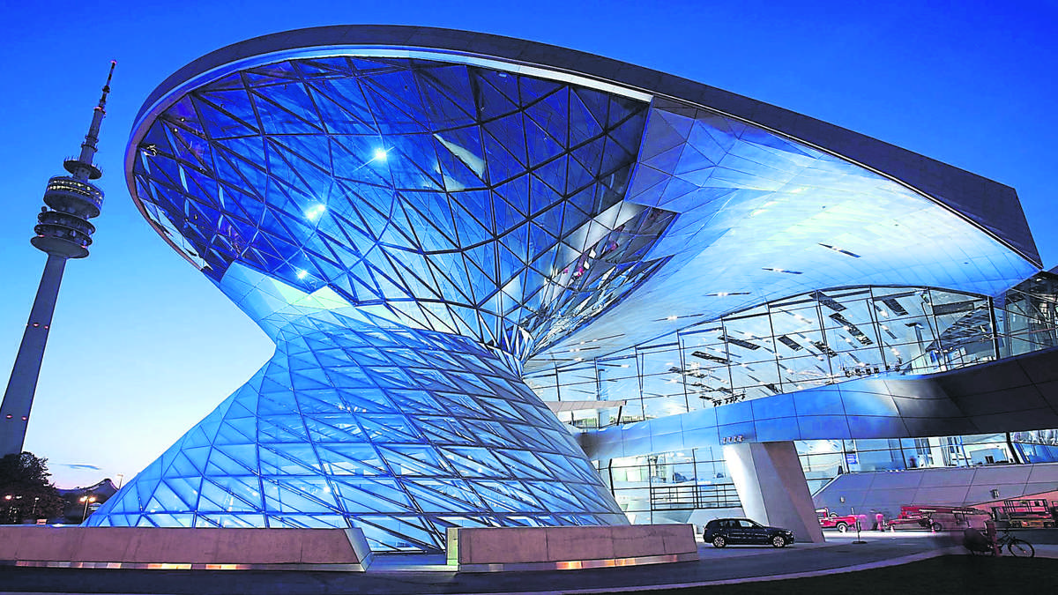
Details of chargers per district

Slide 8
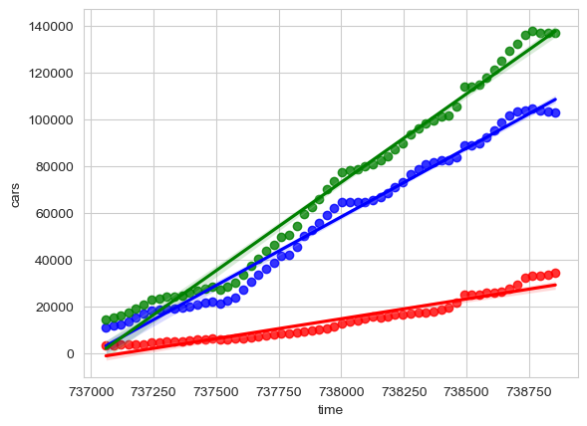
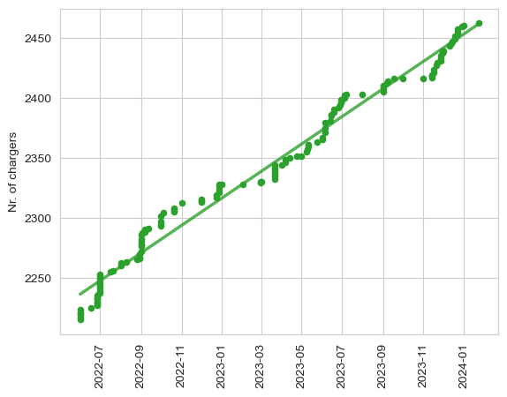
Cars and chargers: regression and prediction

Slide 9
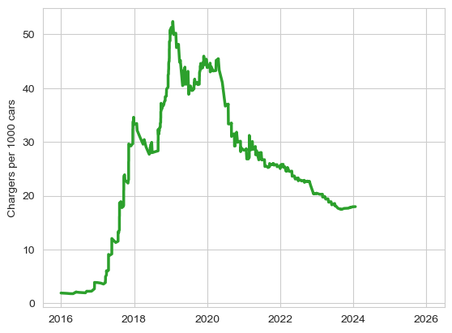
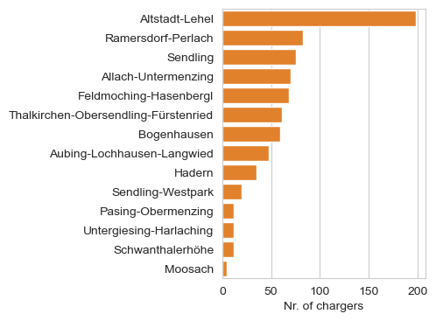
Looking ahead: where to build new chargers?

Slide 10
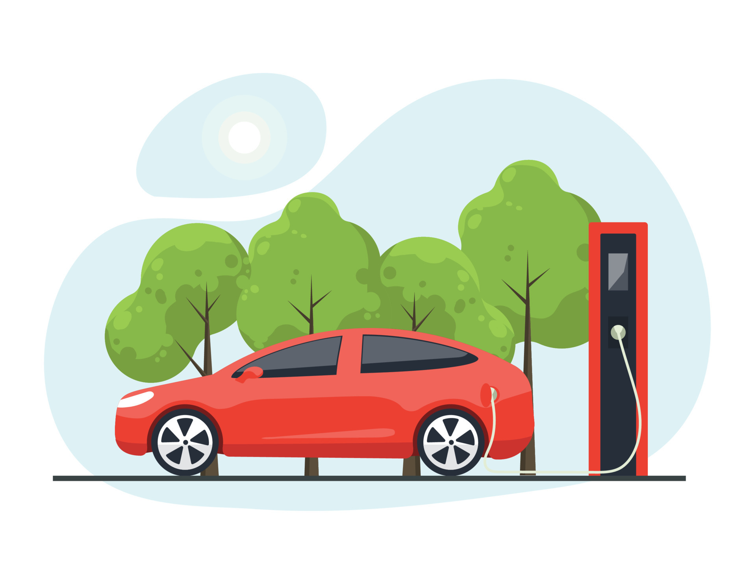
Thank you for your attention!!

